Slide 1

University Database
Rohan Mitra b00085023
Prem Rajendran b00084833
Majed Safadi b00061555

Slide 2
Requirements
The mini-world is a university environment. The database stores data on the students that study in the university, professors that teach at the university, and the courses offered at the university.
The application allows students to add, drop, view all courses, view their personal info (including Standing and Total GPA that are derived), and view their grades for each course.
Moreover, it allows professors to view course statistics, including max, min average and standard deviations of grades of each of the courses that they teach, personal information, courses taught as well as add sections of courses to teach.
Finally, it allows administrators to add, update and delete courses, students, professors and sections.

Slide 3




Data Requirements
Students :
Name
Student ID
Major
Sex
Start_Sem
Credits
Standing
GPA
Courses:
Credits
Course_Code
Course_Name
Sections:
Location
Time
CRN
Semester
PID
Course_Code
Professors:
Name
PID
College
Age
Sex

Slide 4
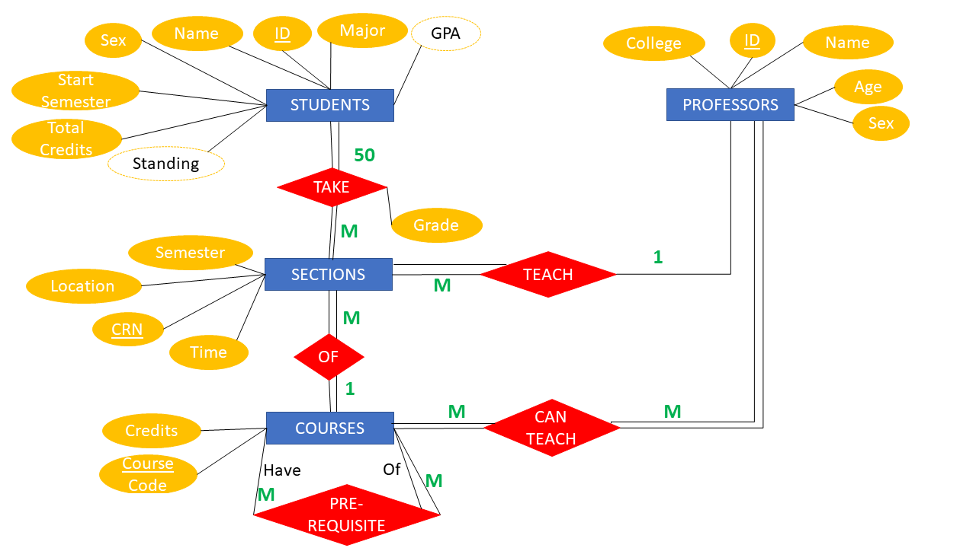
ER Diagram

Slide 5
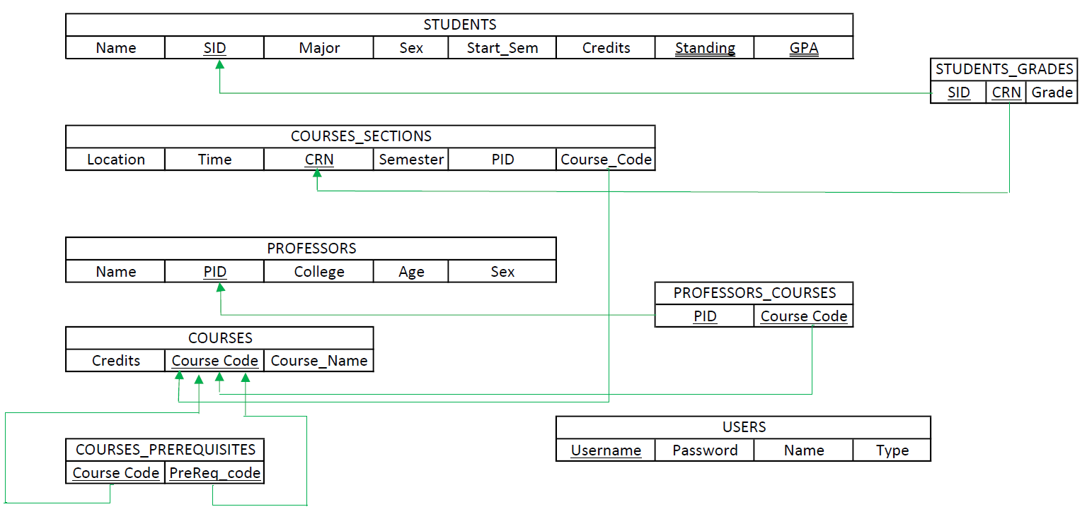
Schema Diagram

Slide 6

Demo of program

